Slide 1
A very complicated and progressive process to generate
Targets
Assignment to campaigns
Creation of business objects on SFDC Service Cloud

Slide 2
Today some UNHCR key users exploit a tailored and custom solution where they can
Select a target (T1) of contacts by using inclusion and/or exclusion criteria
Save this target (T1) as temporary set (S1)
Assign this set (S1) to a specific campaign
If they want, it is possible add and/or subtract new targets (T2, T3) to the previous ones (i.e (S1 minus T2) union t3)

Slide 3
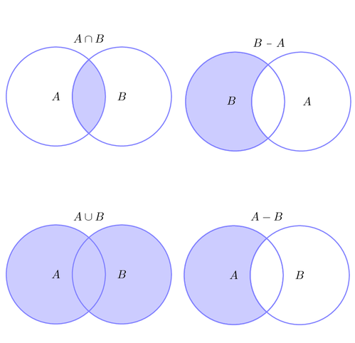

Does EA support “set operations” such as union, intersect and minus ?
Multiple steps of progressive refinements
Inclusion and exclusion criteria
A
1. Step
-
B
2. Step
List of Donors (contact_ids)
Which “Set operators” are available on EA ? -> list of Donor’s IDs
Can we save the temporary results ? (i.e. B – A) and re-use this temp result for other operations / selections ?

Slide 4
Direct Mailing Use Cases
Step 1
Step 2
Step 3
…
Step <n>
Direct Mailing key users
execute a dashboard on Einstein Analytics and generate a first target (T1) of donors_ids
Save this target T1 as a set (S0)
Optionally they can identify a new target T2 and add and/or subtract to set (S0) – the new set is S1
Direct Mailing key users
1) Assign this target (S1) obtained by applying “set operations” to a specific campaign (CMP1) as “campaign members”
2) Optionally we have to create some “cases” related to the contacts (campaign members related to CMP1)
At this stage Direct Mailing Key users have
A set (S1) of contacts (donor ids) on which they want to continue to work
So they can select a new target T3 and add or subtract to S1 by obtaining S2
Also in this case they want to assign this set S2 to a different campaign called CMP2
After “n” steps Direct Mailing Key users have
A set (Sn) of contacts (donor ids) on which they want to continue to work
So they can select a new target Tn+1 and add or subtract to Sn = Sn+1
Also in this case they want to assign this set S3 to a campaign called CMP(n)

Slide 5
How to cover these use cases with Einstein Analytics + manual operation + something else ?
Einstein Analytics
We recommended EA because to overpass limits on reporting (4 objects)
At this stage UNHCR execute many manual operations to change Excel file and send to communication channels (eail, Direct Mailing, SMS, etc)
We are not experts on EA: we have two options:
Temporary tables are available and we can save targets on these temporary tables by applying “set operators” like INNER JOIN, LEFT JOIN, RIGHT JOIN
If no, we need to identify a solution: save the target to excel and then import in a “data set” or what else
SET of contacts (S1, S2 and etc) must be used to create campaign members and optionally cases
When the content of SET is ready to be sent to campaign we need to create automatically new campaign members related to a specific campaign name (i.e. CMP1)
In our architecture we also have:
Heroku that play the role FTP server
ETL (i.e. Talend) to elaborate files (import data on SFDC)

Slide 6
Architecture
We are experienced a lot of issues with REMOTE ACTIONS
Might Talend be an alternative ?
Contact
Account
Donors =
Campaign Members
Campaigns
Inclusion and exclusion criteria
Cases
List of Donors (contact_ids)
<Campaign Name>
Service + NPSP
<Type>, <SubType>
Automatic Creation of Campaign Members and Cases
HEROKU (FTP SERVER) + ETL (Talend)

